Slide 1
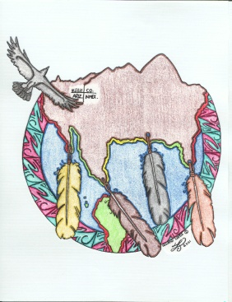

Groundwater and Energy
Tribal Efforts to Mitigate Potential Impacts from Hydraulic
Fracturing; Other Issues and Concerns
Scott Clow
Ute Mountain Ute Tribe
Environmental Law on Indian Lands
Preserving & Protecting Resources
Santa FE, NM
June 16, 2011

Slide 2
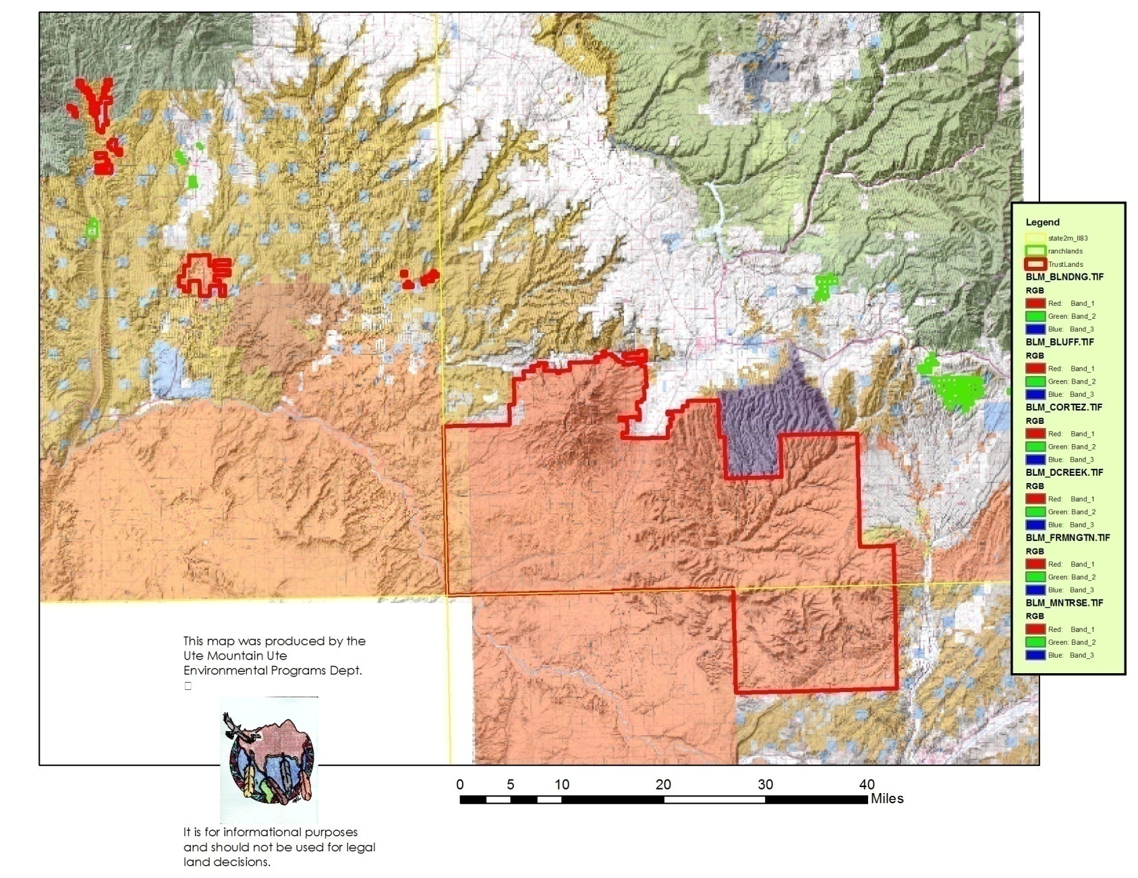
Geographic Extent of Tribal Lands
Ute Mountain Ute Tribe

Slide 3

Ground Water Protection Planning
Ground Water Protection Plan adopted by Tribal Council in 2005
  Non-Regulatory
  Identifies different aquifers
  Uses of ground water from each aquifer
  Vulnerability of aquifers from various impacts
    Pesticides
    Agriculture-Irrigation (nutrient and bacteria enrichment)
    Wastewater
    Energy

Slide 4

Different Aquifers =
Different Issues
Mountain Springs
Towaoc Area
Mancos Creek Farm
Tribal Park
Southern/New Mexico Lands
Farm & Ranch
White Mesa

Slide 5
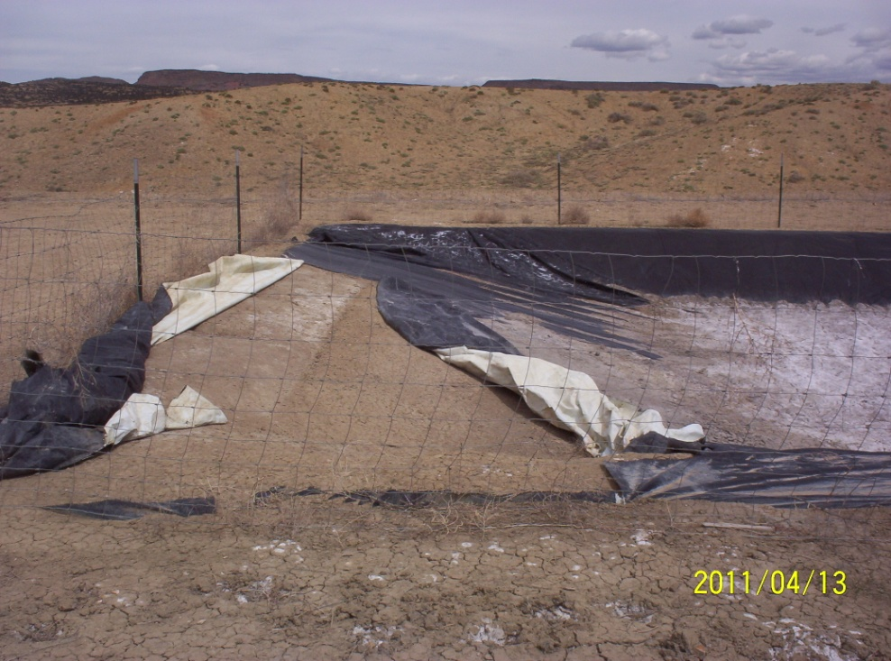
Energy Related Ground Water Vulnerability
Oil and Gas extraction
  Exploration – pit liner integrity and depth to ground water
  Completion – hydraulic fracturing, the big mystery
  Production
    SARA Title 311 chemicals (Superfund Amendments and Reauthorization Act)
    Underground Injection Control Wells
    Transportation & Disposal of products & hazardous materials
  Reclamation
    Plugging and Abandoning
    Surface Reclamation

Slide 6
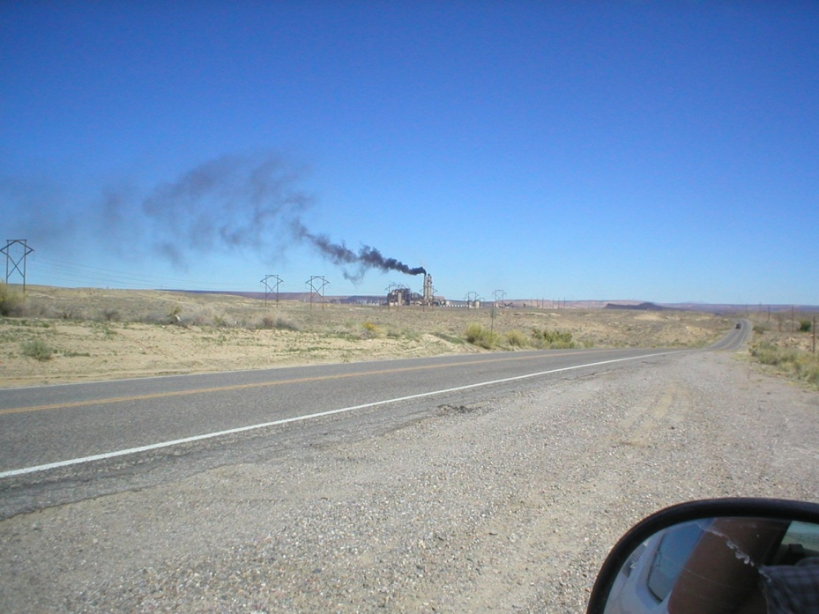

Energy Related Ground Water Vulnerability
Coal Electric Generation
  Local Power Plants
  Local Mines
Uranium
  Mining
    Historic Impacts in Cottonwood Wash Area
  Milling
    Only active privately owned conventional uranium mill next to Ute Mountain Ute White Mesa Community

Slide 7
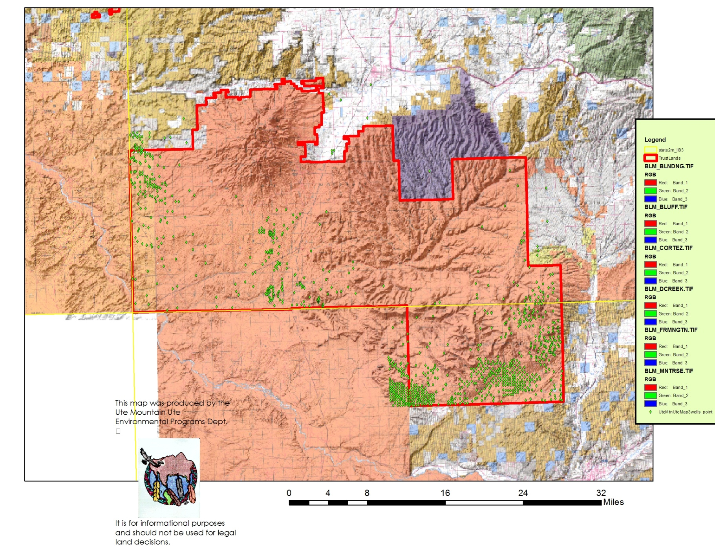
Oil And Gas on Ute Mountain Ute Reservation

Slide 8
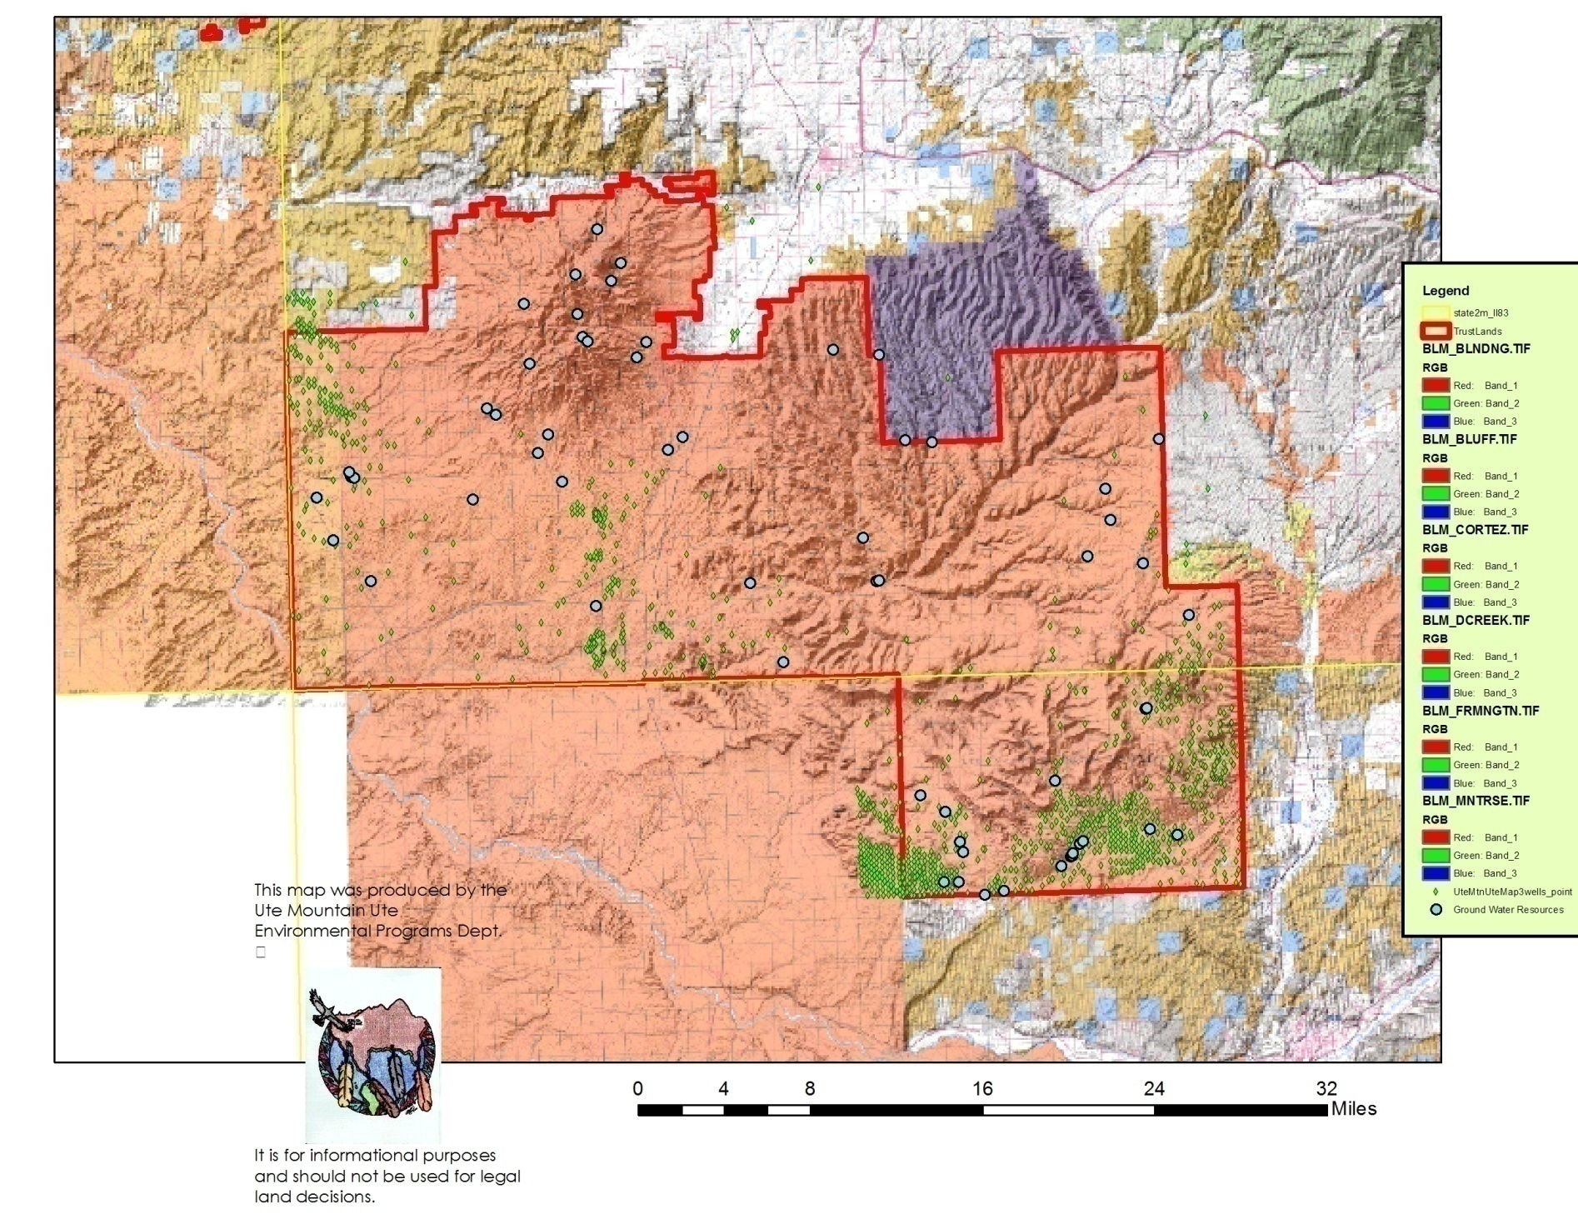
Oil and Gas Wells -- Proximity to Groundwater Resources

Slide 9
Hydraulic Fracturing
The BIG Mystery!?!
Nexus for assessment of vulnerability to contamination from “Frac” through disclosure of fracturing fluid contents
  Current Efforts:
    Disclosure
      “Halliburton pioneered fracturing technology in the mid-1940s, and has always supported and complied with state and federal requirements promoting disclosure of our additives.”
    Research
    Monitoring

Slide 10
  Disclosure –
  Ute Mountain Ute Tribe has requested through the “Application for Permit to Drill” (APD) process that a condition of approval by BLM be the disclosure of fracturing fluid content for well completion to the Tribe’s Water Quality Specialist. (Confidential Business Information status would be respected legally.)
  APD Approval Process:
    On-site inspection of proposed well site location (Co., BIA, BLM, Tribe)
    BIA –Tribe – BIA
    BIA- BLM
    BLM – Company
  Status: 1st company to receive this APD COA has not proceeded to drilling

Slide 11
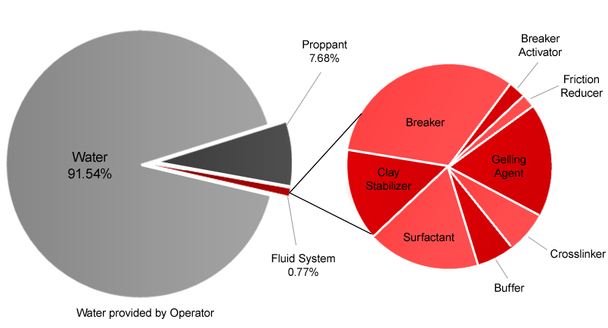
“FRAC is SAFE – isn’t it? ”
Completion companies maintain that it is benign, mostly water and sand and perhaps some detergents…
Citation: Downloaded from Halliburton Website

Slide 12
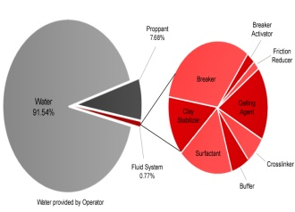
Research
Frac Composition as disclosed on Halliburton Website
One of three formulas described for Colorado Completion Projects
Halliburton Fracturing Fluid “Colorado DJ Basin Hybrid Formula”
Substances | CAS Number | PERCENT | ACGIH TLV-TWA OSHA | PEL-TWA
Potassium carbonate | 584-08-7 | 30 - 60% | Not applicable | Not applicable
EDTA/Copper chelate |  | 10 - 30% | Not applicable | 1 mg/m3
Diethylenetriamine | 111-40-0 | 30 - 60% | 1 ppm (S) | Not applicable
Zirconium, acetate lactate oxo | 68909-34-2 | 30 - 60% | 5 mg/m3 | Not applicable
ammonium complexes
Ammonium chloride | 12125-02-9 | 1-27 % | 10 mg/m3 | 10 mg/m3
Triethanolamine zirconate | 101033-44-7 | 60 - 100% | 5 mg/m3 | 5 mg/m3
Propanol | 71-23-8 | 10 - 30% | 100 ppm | 200 ppm
Glycerine | 56-81-5 | 10 - 30% | 10 mg/m3 | 15 mg/m3
Sodium chloride | 7647-14-5 | 10 - 30% | Not applicable | Not applicable
Hydrotreated light petroleum | 64742-47-8 | 10 - 30% | 200 mg/m3 | Not applicable
distillate
Terpenes and | 68647-72-3 | 1 - 5% | Not applicable | Not applicable
Terpenoids, sweet
orange-oil
Ethanol | 64-17-5 | 30 - 60% | 1000 ppm | 1000 ppm
Crystalline silica, | 14808-60-7 | 60 - 100% | 0.025 mg/m3 | 10 mg/m3 %SiO2 + 2
quartz
Chlorous acid, | 7758-19-2 | 8-10% | Not applicable | Not applicable
sodium salt
Guar gum derivative | n/a | 60 - 100% | Not applicable | Not applicable
Water! | n/a | >90% | Not applicable | Not applicable
EtOH concentration in FRAC: 0.87-2.31 ppt in the range of OSHA hazard level of 1 ppt
Citation: Downloaded from Halliburton Website

Slide 13
Research
Frac Composition as disclosed on Halliburton Website
One of three formulas described for Colorado Completion Projects
Other Formulas' Components
Hydrochloric acid | 7647-01-0 | 10 - 30% | 2 ppm | 5 ppm
Heavy aromatic petroleum | 64742-94-5 | 10 - 30% | 5 mg/m3 | 5 mg/m3
naphtha
Naphthalene | 91-20-3 | 1 - 5% | 10 ppm | 10 ppm
1,2,4 Trimethylbenzene | 95-63-6 | 0 - 1% | 25 ppm | Not applicable
Poly(oxy-1,2-ethanediyl), | 127087-87-0 | 1 - 5% | Not applicable | Not applicable
alpha-(4-nonylphenyl)-
omega-hydroxy-, branched
PRE-FRAC ACID TREATMENT 500-1500 gals
Hydrochloric acid | 7647-01-0 | 10 - 30% | 2 ppm | 5 ppm
Acetic anhydride | 108-24-7 | 60 - 100% | 5 ppm | 5 ppm
Acetic acid | 64-19-7 | 30 - 60% | 10 ppm | 10 ppm
Methanol | 67-56-1 | 10 - 30% | 200 ppm | 200 ppm
Aldehyde | n/a | 10 - 30% | Not applicable | Not applicable
Isopropanol | 67-63-0 | 10 - 30% | 200 ppm | 400 ppm
5-50 gals. of each mixture/1000 gal. of acid with acid treatment
Citation: Downloaded from
Halliburton Website

Slide 14

“FRAC is SAFE – isn’t it? ”
Chemical | CAS # | % in compnent | Halliburton Common Use Description
Sodium chloride | 7647-14-5 | 10 - 30% | Concentrations greater than 1%: Food Grade Salt, Laundry Detergent..
Ethanol | 64-17-5 | 30 - 60% | Ginseng, Deodorizer, Dish Soap, Cologne, Makeup (Mascara), Mouthwash
Ammonium chloride | 12125-02-9 | 1-27 % | Hand Wash, Shampoo, Breakfast Cereal
Zirconium, acetate lactate oxo | 68909-34-2 | 30 - 60% | Industrial paint additive
Diethylenetriamine | 111-40-0 | 30 - 60% | Industrial Epoxy Coating
EDTA/Copper chelate |  | 10 - 30% | Fertilizer for Agricultural Use and Farm Animal Hoof Infection Treatment
Triethanolamine zirconate | 101033-44-7 | 60 - 100% | Adhesives and printing Ink
Hydrotreated light petroleum | 64742-47-8 | 10 - 30% | Oil Wood Stain, Air Freshener, Surface
distillate |  |  | Cleaner Aerosol
Terpenes and | 68647-72-3 | 1 - 5% | Commercial Bathroom Disinfectant Cleaner, Dishwashing Detergent,
Terpenoids, sweet |  |  | Multi-surface Cleaner
orange-oil
Other Formula's Compnents
Hydrochloric acid |  |  | Table Olives, Unripened Cheese, Cottage Cheese
15% Hydrochloric Acid (HCl) | Acid / Solvent | Removes scale and cleans wellbore prior to fracturing treatment | 250-1500 gal run ahead of frac
**Items identified in the "common uses" column were chosen in part because the constituents found in these products exist in roughly the same
as would be found in fracturing materials at the wellhead. In some cases, however, concentrations present in consumer product are either not publicly
available or in higher percentages than would be found at the well site.
Citation: Downloaded from
Halliburton Website

Slide 15
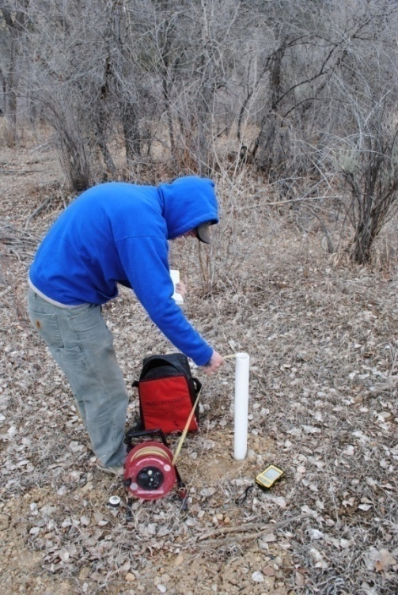
Vulnerability & Risk Assessment
Now that we may be able to identify the chemical constituents of FRAC, we can determine vulnerability to pollution using:
  Chemical Mobility & Reactivity
  Solubility in Water
  Ground Water hydrology
  “Can we detect it in a water sample?”
UMU WQ Specialist Colin Larrick

Slide 16
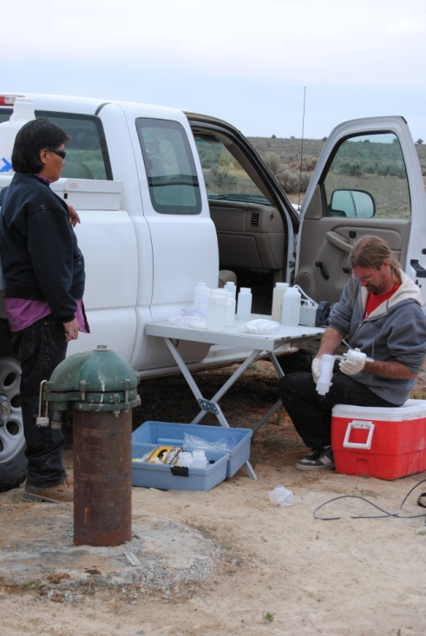
Monitoring
Clean Water Act Section 106 Funded Monitoring and Assessment Program
  Developing sampling and analysis protocols for specific constituents of FRAC
  Could not do this before
    - shooting in the dark is not
    cost effective!
UMU WQ Technicians Judy Lehi and Jamie Ashmore

Slide 17
Spill Reporting
Reporting Procedures in Place
Spills Code being developed for enforcement
  Better to report it than not to report it

Slide 18
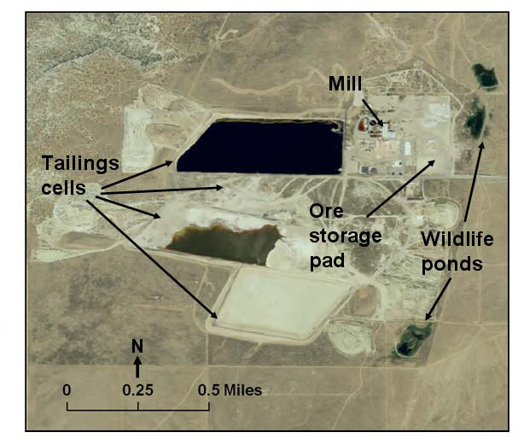
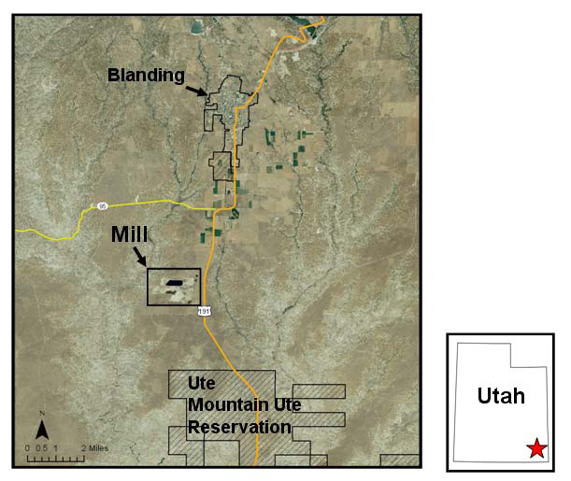
Other Energy Related Groundwater Protection Efforts by Ute Mountain Ute Tribe
White Mesa Uranium Mill, SE Utah

Slide 19
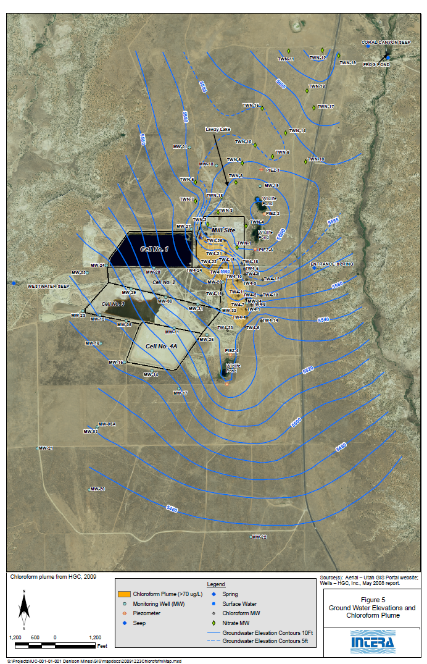
Ground Water Contaminant Plumes at Mill Facility -
Chloroform
Chloroform first identified in groundwater in 1999

Slide 20
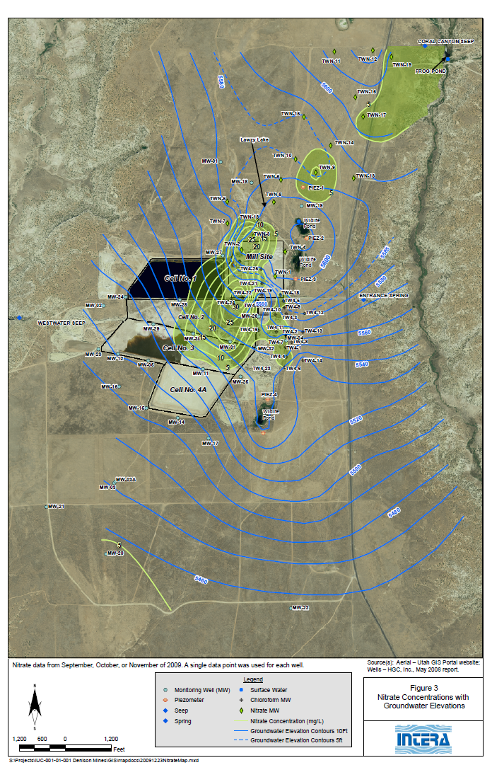

Ground Water Contaminant Plumes at Mill Facility - Nitrate
Nitrate and chloride identified in groundwater in ~2009

Slide 21
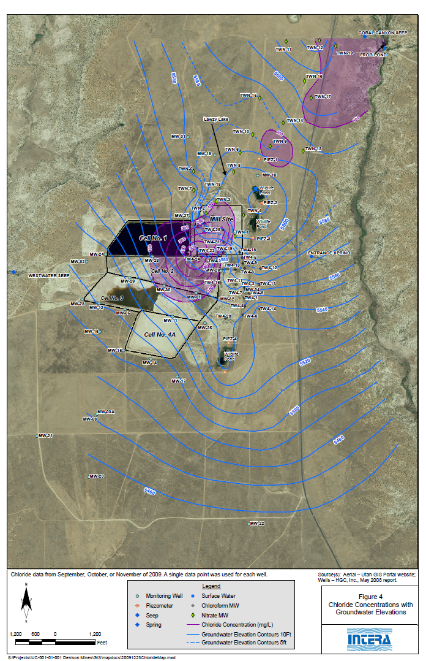
Ground Water Contaminant Plumes at Mill Facility - Chloride

Slide 22
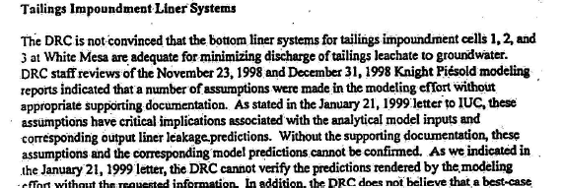
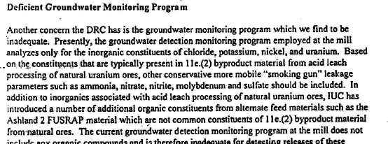
GRAMA Request (State of UT FOIA)
Citation:
2/11/1999 letter to IUC from UT DRC

Slide 23
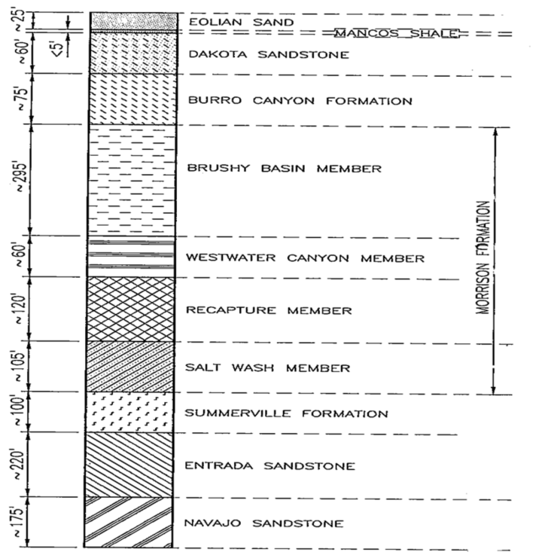
Vulnerability of Tribal Water Supply
Figure 2. Stratigraphic column for White Mesa, Utah (Titan Environmental Corporation, 1994).

Slide 24
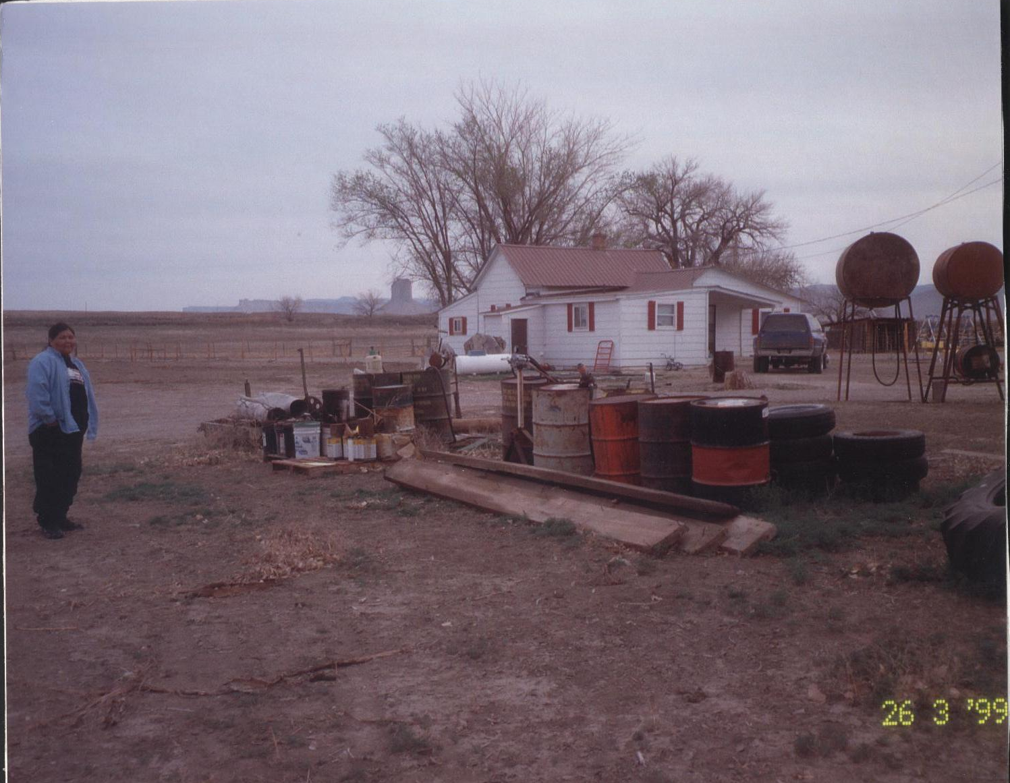
Pesticide Remediation through Brownfields-Tribal Response Program

Slide 25
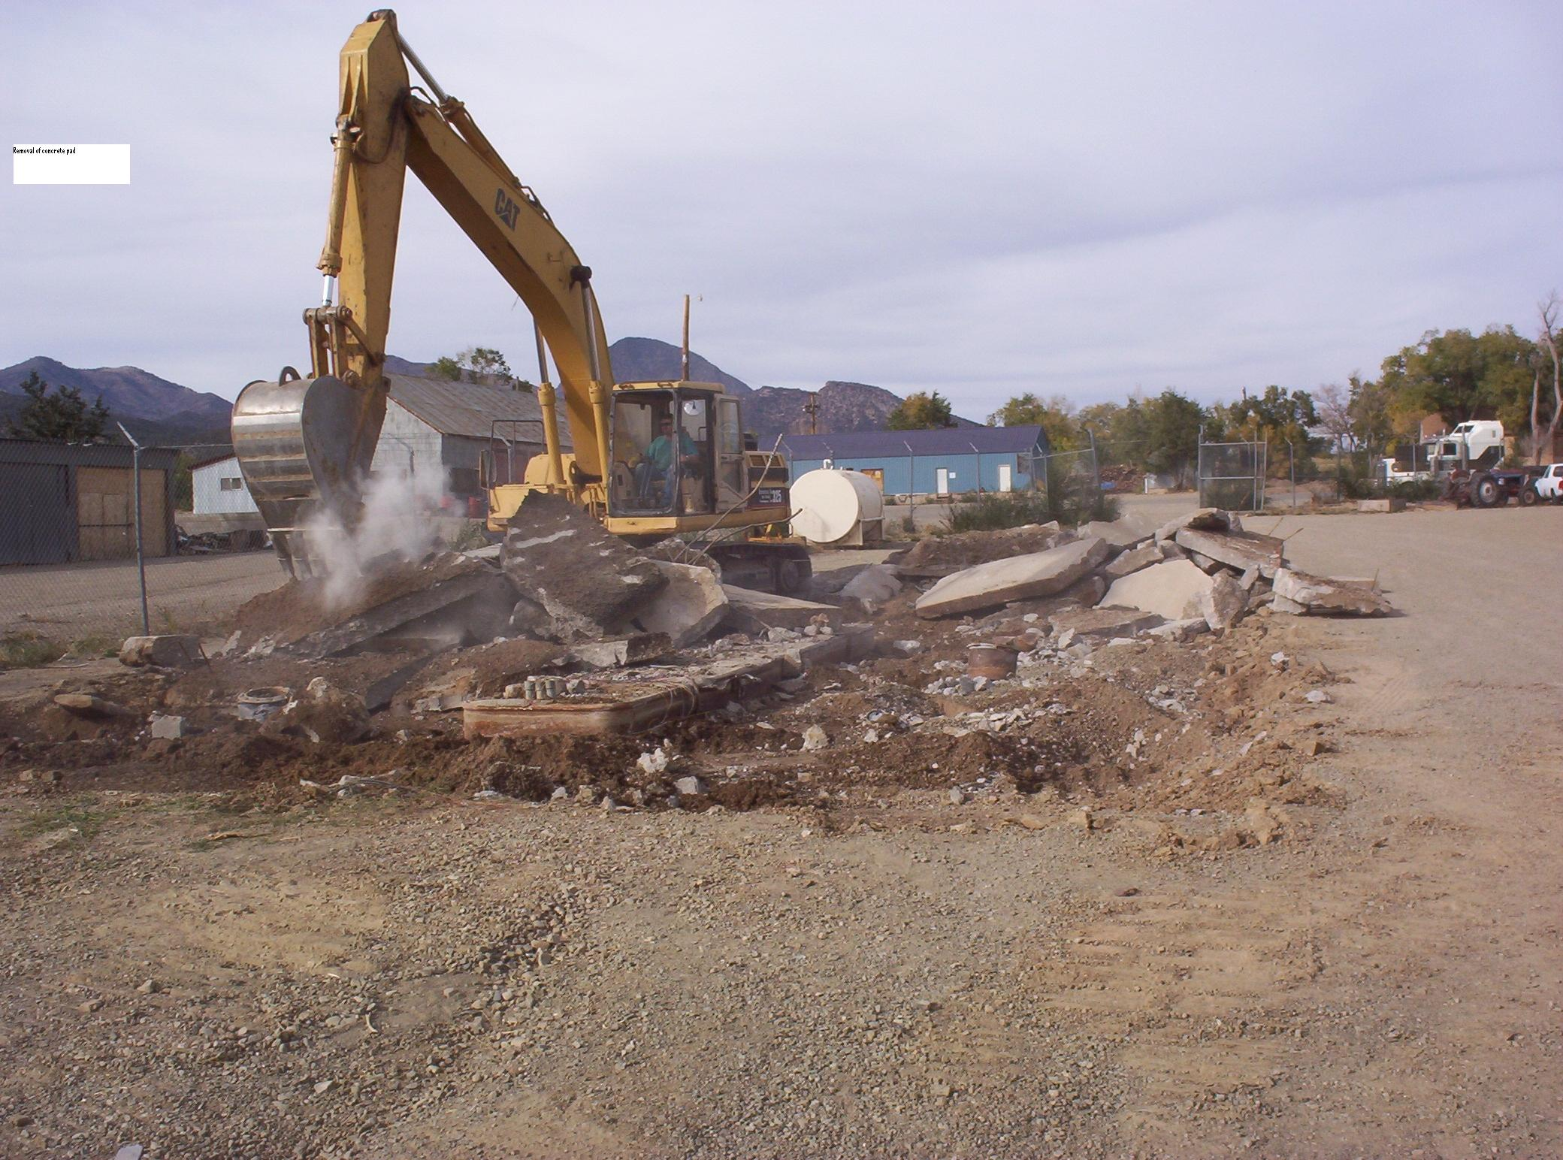
UST Program-Tank Removal

Slide 26
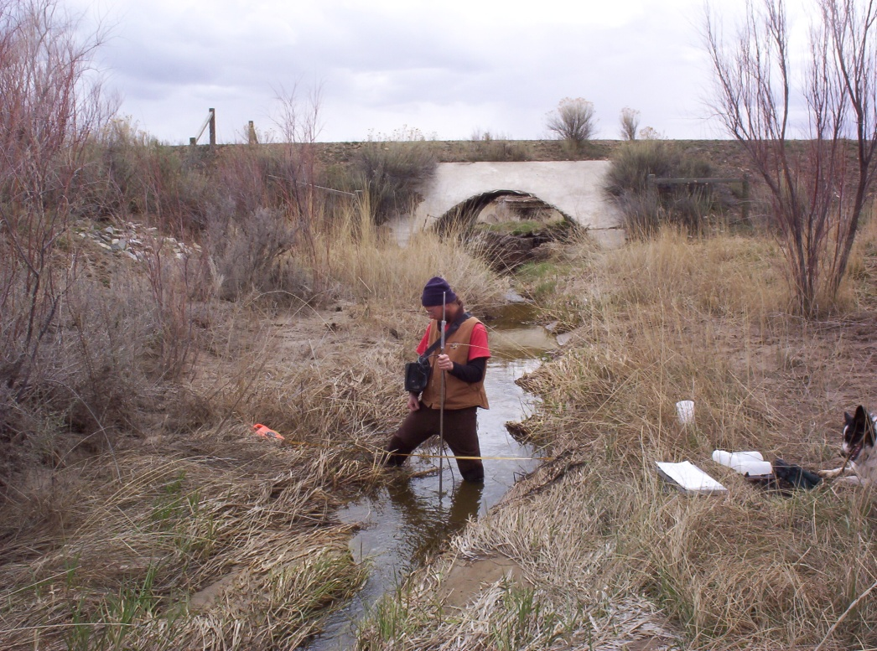
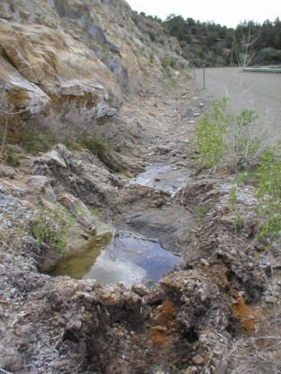
The Good ol’ Days

Slide 27
Always Remember WHY You DO it!
Thanks for having me
Scott Clow
970-564-5432
sclow@utemountain.org
utemountainuteenvironmental.org

